Slide 1
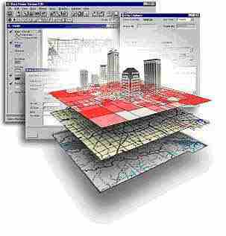
Geospatial Research Methods
GSP 510
Instructor: Jim Graham
E-mail: James.Graham@Humboldt.edu

Slide 2
HSU Sits on Traditional Wiyot Land
Please respect the traditions of our local tribal members
http://www.historicjusticealliance.org/

Slide 3
About the class
This is an introduction to how to properly use geospatial data and methods in research
The class substitutes for GSP 101 and GSP 270
The class is for graduate students and thus the amount of work will be much higher than either of the other classes!
This class will prepare you for GSP 216, GSP 316, GSP 370 and so on…

Slide 4
Jim Graham
Bachelor's in CS and Math from Chico State
Over 20 years as a software engineer
15 with HP as an engineer and manager
Owner of tecBugs and now SchoonerTurtles
PhD from Colorado State U. in Forestry/GIS
Eight years with the Natural Resource Ecology Laboratory at Colorado State
Two years with Oregon State U.
17 years doing GIS, 8 years teaching GIS
Research with: State Dept., USGS, USDA, DOE…

Slide 5
But who am I really?
Grew up loving the mountains of California
Usually had a 24k topo in my back pocket
Discovered computers
Put together computers and maps to solve problems
After over 20 years in the commercial world, returned to academia to teach and help improve decisions on how we interact with the natural world (because I am worried!)

Slide 6
This class is about Research with Spatial Data and Methods
We will not cover everything you need to know to be successful
We will cover the basics and how to learn what you need to know to be successful

Slide 7
Research Process
Products
Acquire/Create Data
Create
Products
QAQC
Data
Analysis
Prep
Data

Slide 8
What is a GIS?
Geographic Information System
Something (typically a computer) that provides information based on spatial data (locations of stuff)
Includes: ?

Slide 9
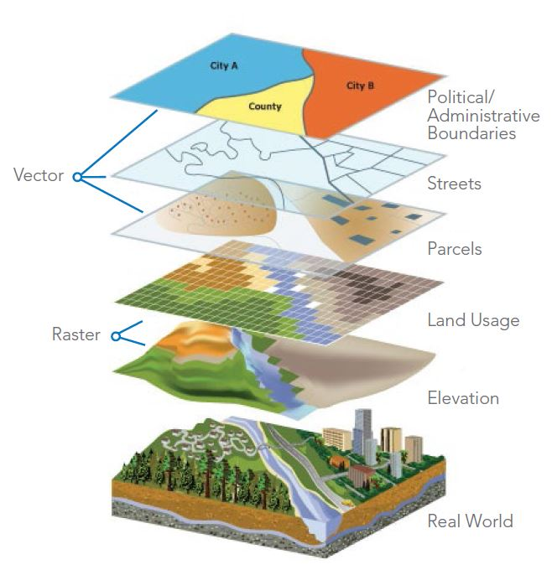
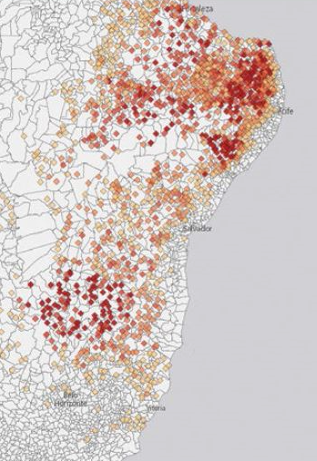
What is GIS?
A Geographic Information Science
Using spatial data and analysis to create new information
Also, what academics wish GIS stood for.
Better
Decisions
http://data-informed.com/how-spatial-analysis-leads-to-insight/

Slide 10
Why are we here?
For me:
Help you get the career you want
Improve the world for all living things
From students:
Learn
Career prep
Stay heathy
Get their monies worth

Slide 11
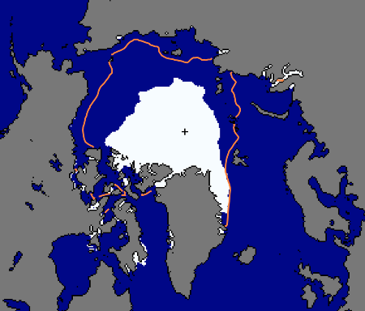
To Help Make Better Decisions
Sept. 24, 2012
National Snow and Ice Data Center, 2012

Slide 12
Antarctic Ozone Hole
Largest Antarctic Ozone Hole
September 2006

Slide 13
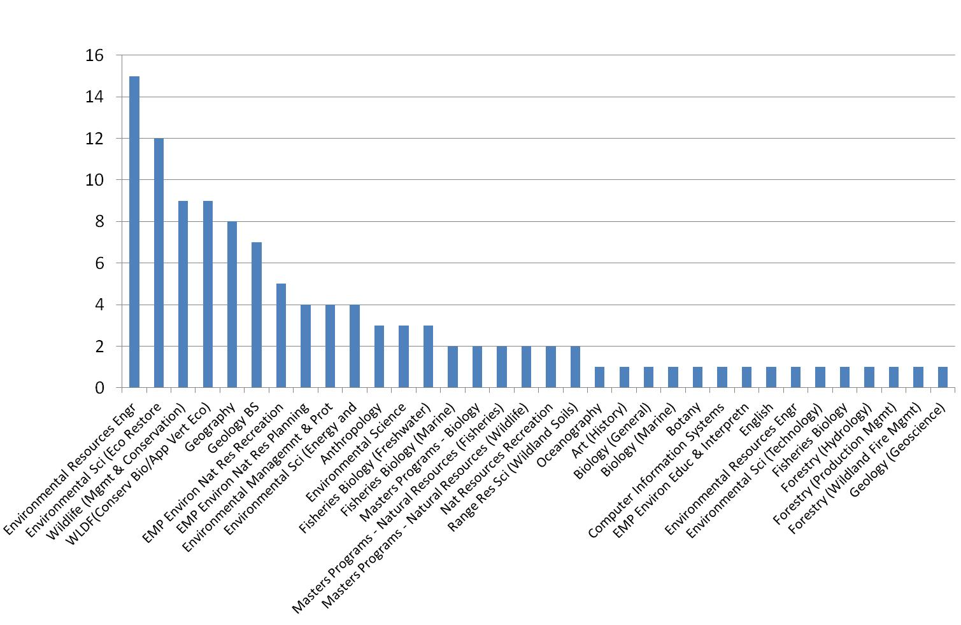
Who's using GIS?
“Bolstad: From Archeology to Zoology”

Slide 14
Anything else you need from me?
Visual resources
In-class demos (no death by ppt)
Non-critical learning environ.
Hands on
Clear expectations
Research examples
Repetition of key concepts
Interpret data
Feedback
Practical apps
Personal experiences
Organize data
Map mobile sediments, social science
GIS Software
Make maps
Assessable
Useful supplemental materials
GIS resources
Notes:
D

Slide 15
The Class Materials
Canvas is used for assignments and grades
Home page has links for everything else
Class web site: All the content (except videos)
gsp.humboldt.edu -> Academics -> Online Learning Materials -> GSP 510
YouTube has the videos
We will also share a GoogleDrive
I cannot cover all the material in the videos. You’ll need to read ahead, ask questions, and review the material again.

Slide 16
Class Organization
The schedule is organized by “Online Learning Modules” divided into weeks
Each week:
Review the web site and videos and do the indicated readings and activities
Synchronous Lab Sessions
Start your lab on Thursday and get it done by Monday!
Turn it in the following Thursday and so on
Quizzes “periodically” instead of tests
During the final time, you’ll be presenting projects

Slide 17
Virtual Learning
This class is online with a few labs being outside and face to face
For face to face, we will need to follow HSU guidelines
For those that are remote, we will be mailing you the equipment you don’t have available and you can do the labs individually
The additional online material includes:
Videos on YouTube
Canvas Quizzes

Slide 18
Class Sessions
We will not have regular lectures face to face
These are replaced by YouTube videos
Linked from Canvas
Please review the videos and complete the associated Canvas quizzes
We will have “synchronous” Zoom meetings during lab time

Slide 19
Using Zoom
When using Zoom, please:
Mute your microphone when not talking
Don't turn off your video in participatory meetings unless you are having Internet issues
Only chat to the group, or the teacher during group meetings
If folks are talking, just raise your hand and I'll call on you (unless it is one of those long pauses where I’m looking for students to answer questions and no one wants to ;-)

Slide 20
Technology
You will need access to a computer or Chrome book and a good Internet connection to efficiently finish this class.
ITS has computers to borrow
Please check your Internet and connect me or ITS to figure out how we can resolve any issues.

Slide 21
To be successful
Turn in lab assignments on time!
Attend class, do the readings, etc.
Ask questions on confusing topics
Make good decisions
Follow the 20 minute rule:
If you’re stuck more than 20 minutes, get help
What is your learning style?
www.vark-learn.com/english/page.asp?p=questionnaire

Slide 22
Working Together
Technology is moving really fast
However, society is not keeping up
We need “norms” so we can work together constructively
Respecting everyone is key
To communicate effectively, you have to communicate from the other persons perspective
Remember, you’re sitting in a room of potential collaborators

Slide 23
Communication
I communicate primarily through email and in person
Please write professional emails, not:
“Yo, what assignment. Sent from my iPhone”

Slide 24
Emails
Proper subject line
Provide context so the reader understands the message
Provide a formal signature
For important emails, I write them and then re-read them later
For emotionally-charged emails, I write them, re-write them, have someone review them, and then don’t send some of them.
Instead, I’ll go out to lunch with the person

Slide 25
Bottom Line
The more time you spend working with a GIS, the better you will do
If you work hard and do the assignments on time
Me (and others) will be there to help you when needed
You just need to ask!
Be ready to help others as well

Slide 26
A few other things…
There will be a lab assigned this week and due next week!
Don’t forget to do the readings, videos, & quizzes for this week

